Slide 1



Test Automation 11th September 24
Ash and Emily

Slide 2


Agenda
Why test automation – 5m
Explain the task – 10m
Have a go – 20m
Give us feedback - 5

Slide 3

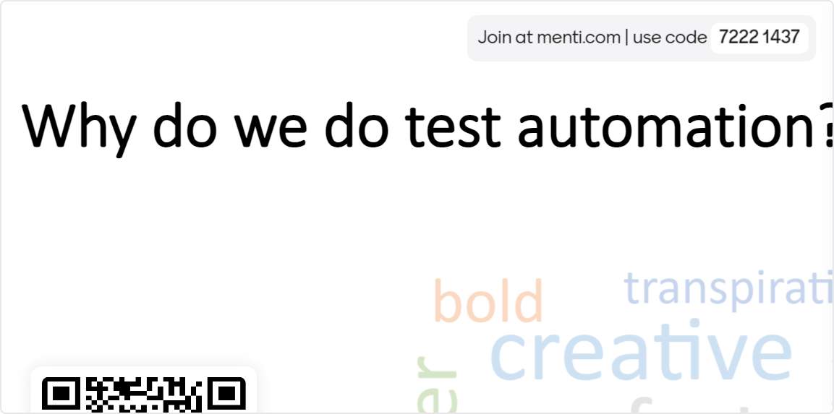
Why do we do test automation?

Slide 4
Dispelling the myth
Objective: Show how easy it is to get started
Taken away installation but is very simple and if interested can be found here:
You have
Laptop with Visual studio code and internet access
Github repo with playwright installed
Node installed
A basic repo cloned and a branch created emypenguin87/PlaywrightDemo (github.com)

Slide 5
The task
2 options:
UI test to log in to an application
Navigate to URL Swag Labs (saucedemo.com)
Enter username
Enter password
Click login
Assert (confirm) user is logged in
API test to call an API endpoint – API documentation for https://pokeapi.co/
Call a get endpoint e.g. http://pokeapi.co/api/v2/pokemon/charmeleon
headers: {'Content-Type': 'application/json’,}
Confirm success response (200)
View the response
What abilities does your pokemon have?

Slide 6
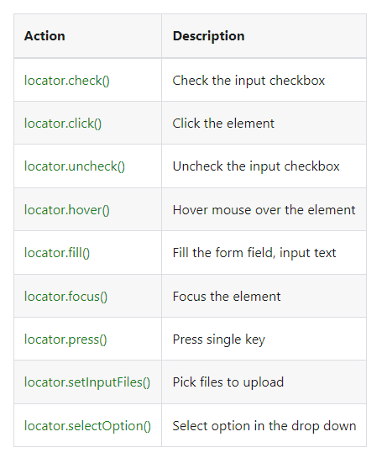
Tips
npx playwright test –ui | Type into terminal to open Playwright UI
API testing | Playwright | Info writing API test
Writing tests | Playwright | UI test writing basics
LocatorAssertions | Playwright | Assertions for elements
https://playwright.dev/docs/intro#running-the-example-test-in-ui-mode | Info running in UI mode

Slide 7
Future
Page Object model, BDD and other best practice - Best practice / Principles of test automation - Test Automation - Confluence (atlassian.net)

Slide 8
Example solutions – API test
test('I can find information about Charmander', async ({ request }) => {
const response = await request.post(`http://pokeapi.co/api/v2/pokemon/ditto`, {
headers: {
'Content-Type': 'application/json',
}})
console.log(await response.json())
expect(response.status()).toBe(200)
});

Slide 9
Example solutions – UI test
test('I can log into to SwagLabs', async ({ page }) => {
await page.goto('https://www.saucedemo.com/');
// Expect a title "to contain" a substring.
await expect(page).toHaveTitle(/Swag Labs/);
await page.locator('[data-test="username"]').fill("standard_user");
await page.locator('[data-test="password"]').fill("secret_sauce");
await page.locator('[data-test="login-button"]').click();
await expect(page.locator('[data-test="shopping-cart-link"]')).toBeVisible(); });

Slide 10


What have you learnt today?

